Slide 1
Neuroscience Graduate Program
Boot Camp 2020
Jing Wang and Stefan Leutgeb
Biophysics Overview

Slide 2
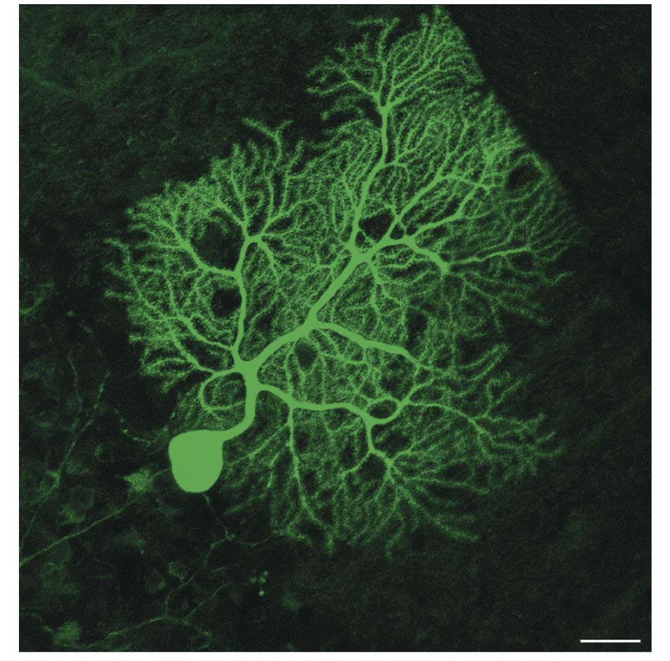
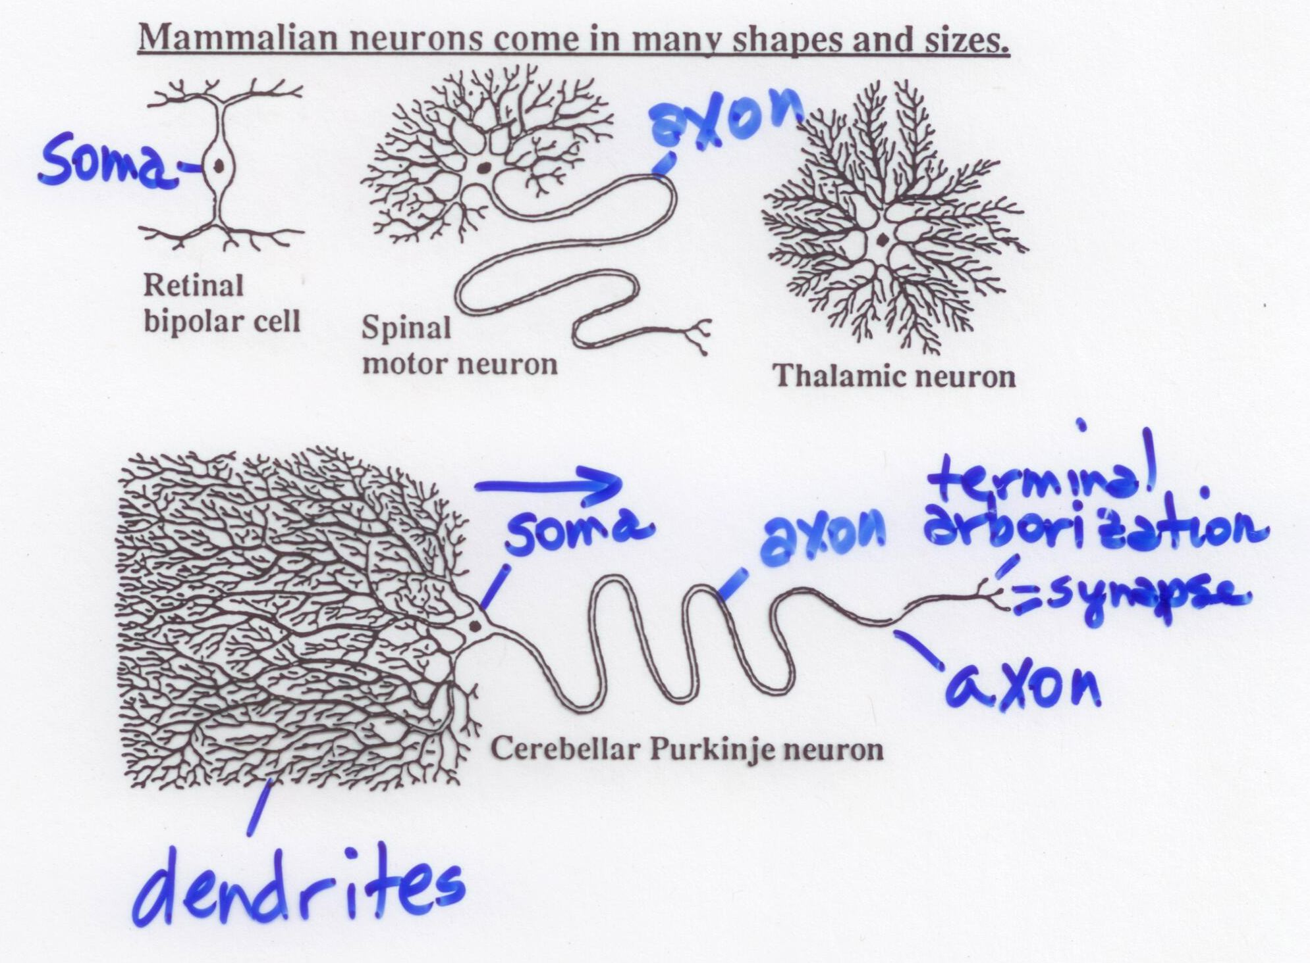
The membrane potential of neurons
V_{m}
Membrane potential is the voltage measured across the cell membrane;
it is represented as V_{m}
In electrophysiological recordings, the extracellular fluid is assigned a charge
that is 0 (i.e., ground).

Slide 3
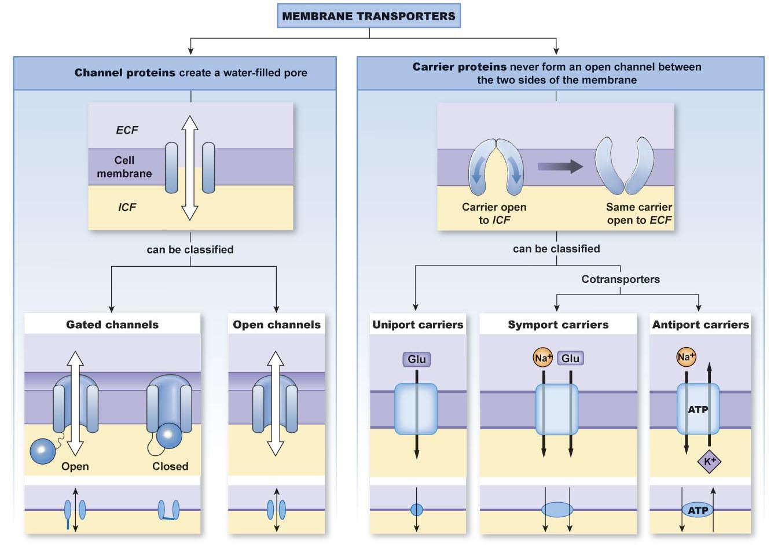

Slide 4
Channel proteins/Ion channels
channel proteins create a water-filled pore
Na+ channels, K+ channels, Ca++ channels, Cl- channels
monovalent cation channels, cation channels
the ease with which ions flow through a channel is called conductance, facilitated diffusion
open channels or pores are usually open
leak channels
gated channels open and close in response to signals
(a) mechanically gated ion channels
physical forces, i.e., stretch, pressure
(b) chemically gated ion channels (nicotinic, muscarinic, …)
extracellular and intracellular ligands
(c) voltage-gated ion channels
cell’s membrane potential

Slide 5
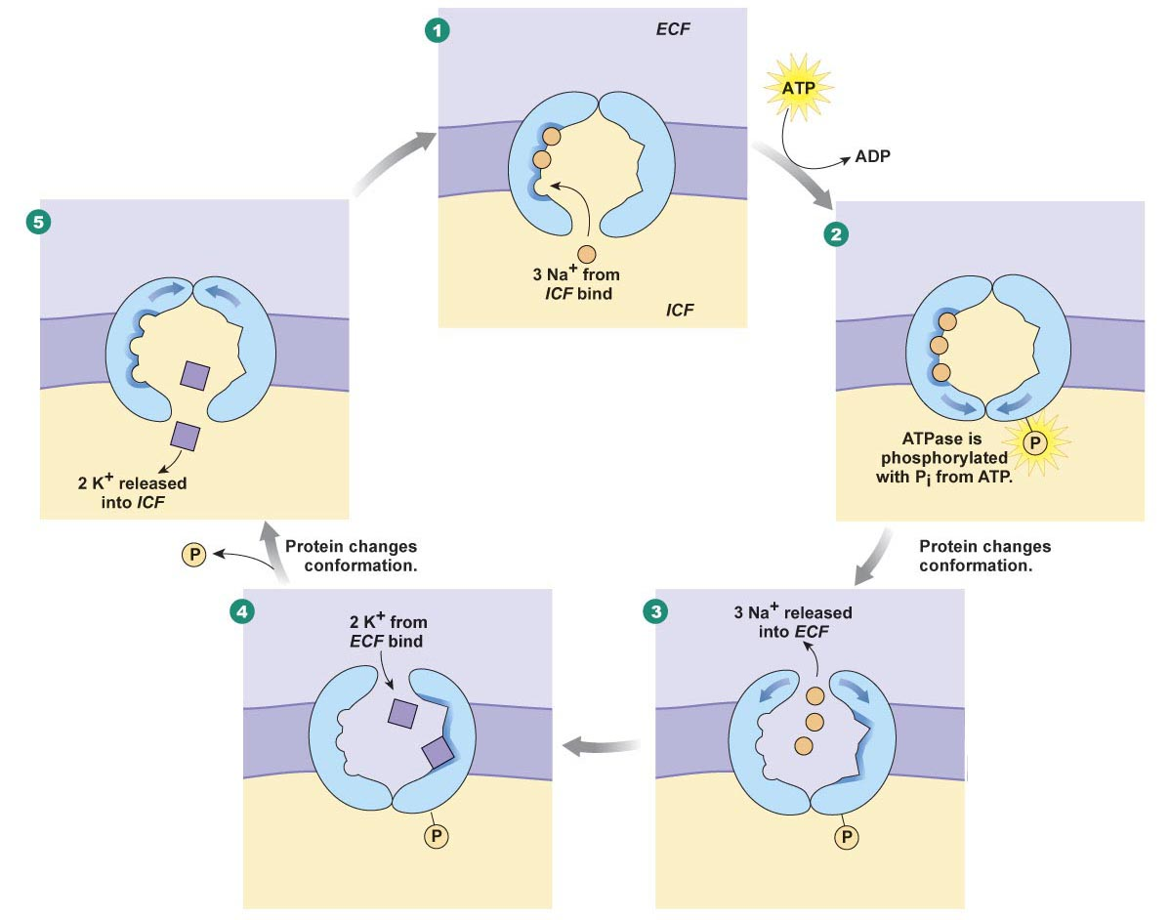
Carrier proteins/sodium-potassium pump

Slide 6
The origin of the membrane potential
The inside-negative resting membrane potential is generated by
the imbalance from pumping 3 positive Na ion out while pumping only 2 positive K ions into the cell
by letting K+ freely move between the inside and outside of the cell
by pumping Na+ out of the cell while the more negatively charged proteins than positive ions remain in the cell

Slide 7
Forces acting on an ion (X⁺) in a channel permeable only to that ion
Y⁻
Y⁻
X⁺
X⁺
X⁺
Y⁻
Extracellular (EC)
+ + + + + + + +
+ + + + + + + +
+ + + + + + + +
+ + + + +
X⁺
_ _ _ _ _ _ _ _
_ _ _ _ _ _ _ _
_ _ _ _ _ _ _ _
_ _ _ _ _
Intracellular (IC)
Y⁻
Y⁻
X⁺
Y⁻
X⁺
X⁺
X⁺
Y⁻
Y⁻
X⁺
Y⁻
Y⁻
X⁺
Y⁻
X⁺
Y⁻
X⁺
Y⁻
X⁺
Y⁻
X⁺
Y⁻
X⁺
Force toward EC: chemical concentration gradient = RT ln
[X]_{out}
[X]_{in}
Force toward IC: electrical concentration gradient = z_{x}F V_{m}
[X]_{out}
At equilibrium, the forces are equal: RT ln = z_{x}F V_{m}
[X]_{in}

Slide 8
[X]_{out}
At equilibrium, the forces are equal: RT ln = z_{x}F V_{m}
[X]_{in}
RT
[X]_{out}
Solve for V_{m}: V_{m}= ln
= E_{x}
z_{x}F
[X]_{in}
This is the Nernst Equation
• the equilibrium V_{m} gets a special name E_{x} which is called
“the X equilibrium potential”
(the potential at which ion X is at equilibrium)
The Nernst Equation is usually written in log to the base 10 rather than ln,
and the constants are lumped together. At 25 °C:
59 mV
[X]_{out}
E_{x}= log
z
[X]_{in}

Slide 9
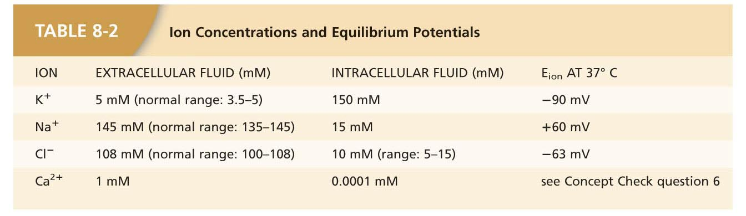
59
[X]_{out}
59
150
E_{Na}= log
E_{Na}= log
z
[X]_{in}
+1
15
59
log 10 = 1
E_{Na}= log 10
+1
E_{Na}= +59 mV

Slide 10
Equilibrium potential is the potential when the net flow of an ion is zero.
Resting membrane potential is the potential when the net current flow in and out of a cell is zero.
Reversal potential is the potential when the net current flow through a channel reverses. The net current is zero at the reversal potential.
If a channel is only permeable to a single type of ion (e.g., K+), its reversal potential is equal to the equilibrium potential for the ion.
If a cell has only ion channels open that are permeable to a single ion (e.g., K+) the resting membrane potential is equal to the equilibrium potential for the ion.

Slide 11
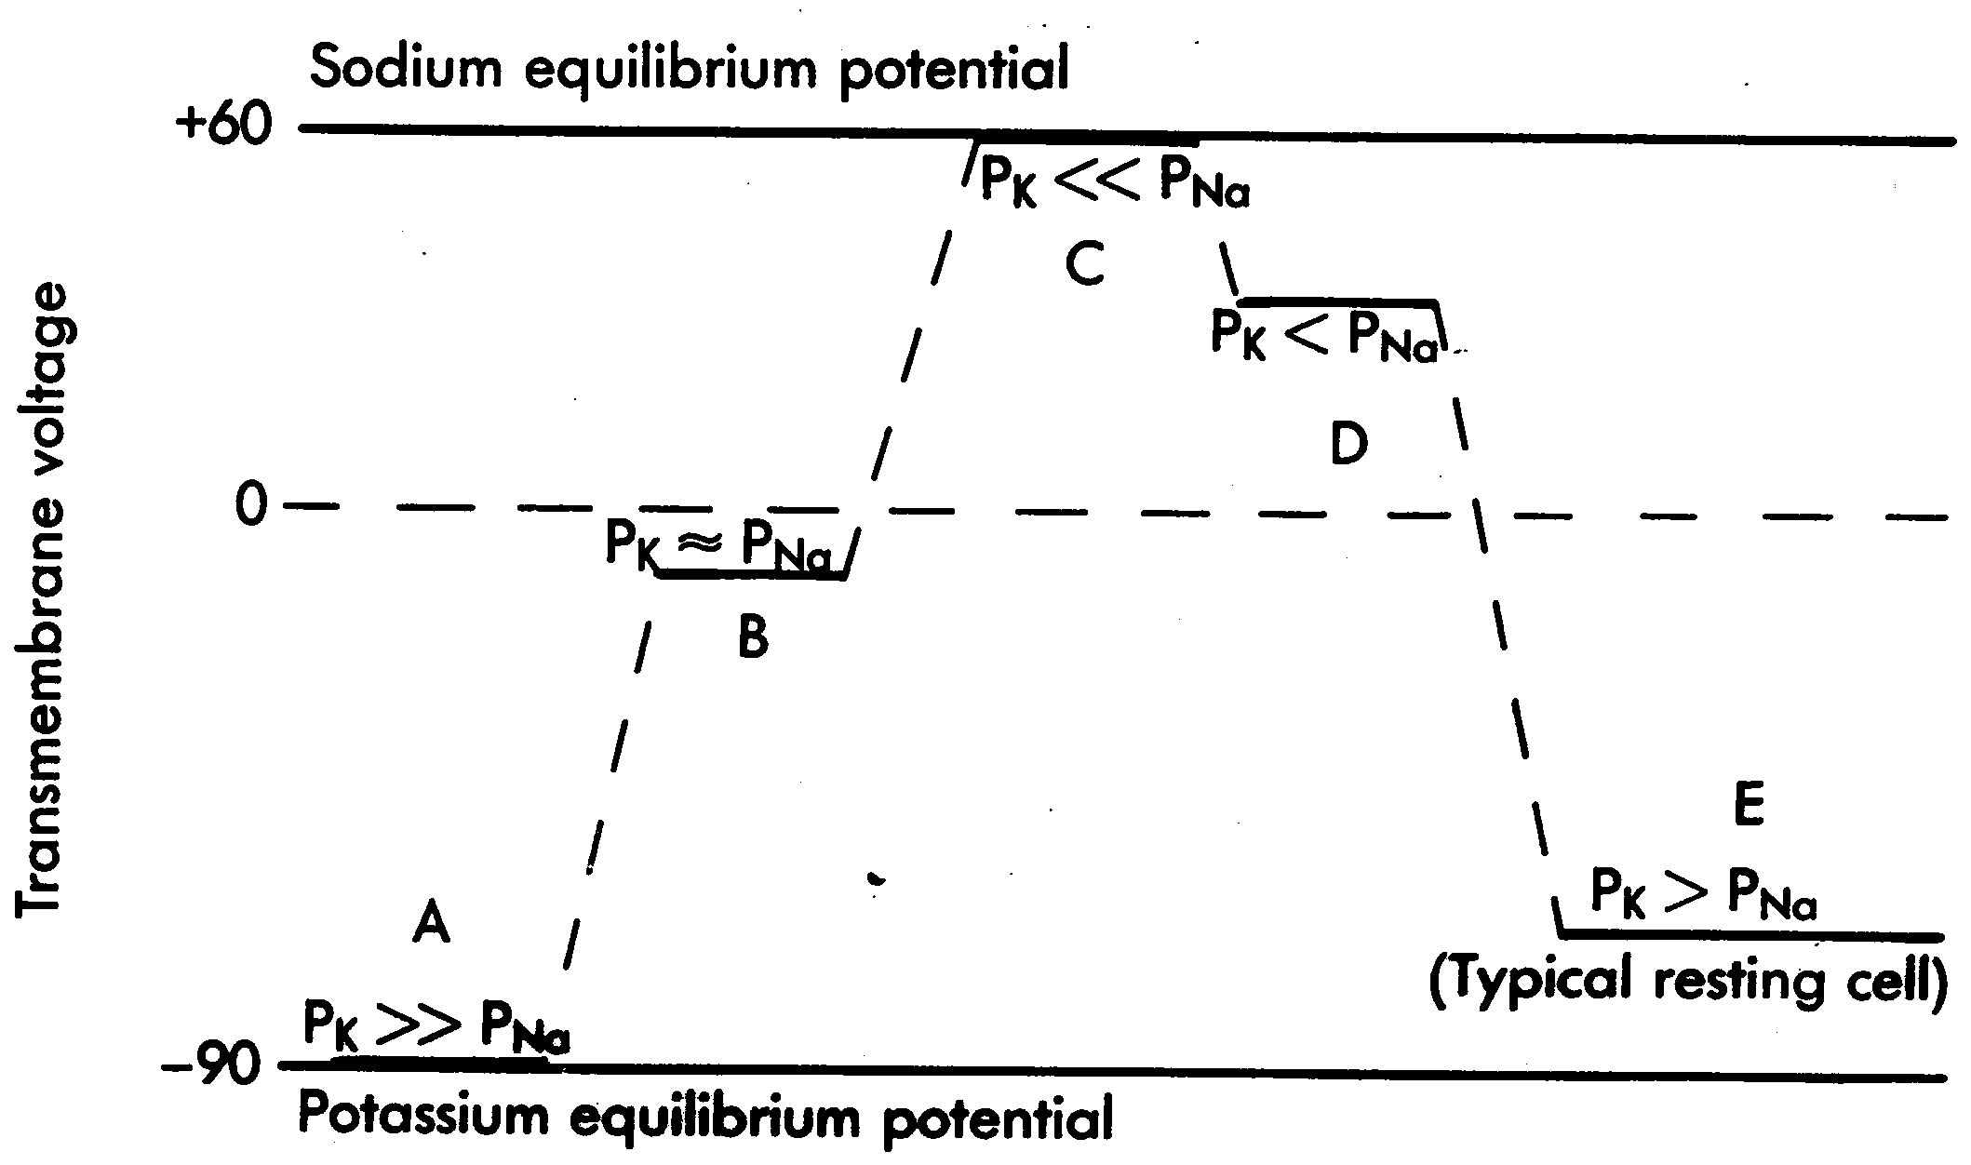
Note: Permeabilities (Px) are used for the Goldman equation; conductances (Gx)
are used for the resting potential equation. For present purposes, they are equivalent.

Slide 12
More channels ...
If Na+ channels suddenly open and K+ channels close, which one is reached first and which is reached at equilibrium
Na+ ions flow until the membrane potential reaches 0 mV
Na+ ions flow until the Na+ concentration inside and outside of the cell is equal.
Na+ ions flow until the Na+ equilibrium potential is reached

Slide 13
Three major ions determine the membrane potential at rest:
Cl⁻
Cl⁻
Na⁺
Na⁺
Cl⁻
Na⁺
Na⁺
Cl⁻
K⁺
Na⁺
Na⁺
Na⁺
Cl⁻
Na⁺
Cl⁻
K⁺
Cl⁻
Na⁺
Na⁺
Cl⁻
Na⁺
Cl⁻
Na⁺
K⁺
K⁺
Org⁻⁻
K⁺
K⁺
Org⁻⁻
Na⁺
K⁺
K⁺
K⁺
Org⁻⁻
Org⁻⁻
Cl⁻
Org⁻⁻
Na⁺
Org⁻⁻
K⁺
K⁺
K⁺
K⁺
Cl⁻
Resting potential (V_{m}) is a combination of the 3 equilibrium potentials:
G_{K}
G_{Na}
G_{Cl}
V_{m} = E_{K} + E_{Na} + E_{Cl}
∑G
∑G
∑G
[where ∑G = G_{K} + G_{Na} + G_{Cl} ]
More ion types? Just add more terms.

Slide 14
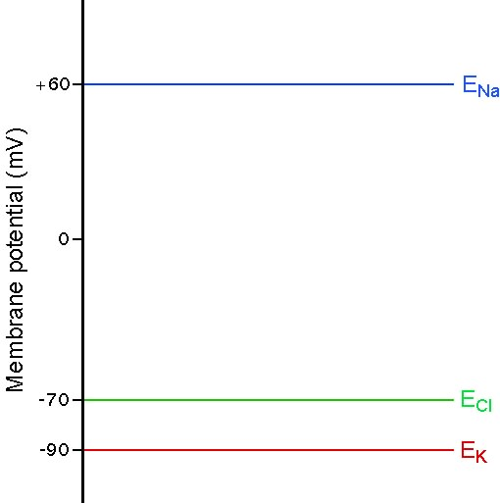
G_{K}
G_{Na}
G_{Cl}
Resting potential = V_{m} = E_{K} + E_{Na} + E_{Cl}
∑G
∑G
∑G
[where ∑G = G_{K} + G_{Na} + G_{Cl} ]
If:
G_{K} = 80 nS
G_{Na}= 15 nS
G_{Cl} = 5 nS
then:
V_{m}= -66.5 mV
and:
I_{Na}= -1897.5 pA
I_{Cl} = +17.5 pA
I_{K} = +1880 pA
V_{m}
[using: I_{x} = (V_{m} – E_{x}) G_{x} ]

Slide 15
I_{X} = (V_{m} – E_{X}) G_{X}
where (V_{m} – E_{X}) is the “driving force”
and G_{X} is the pathway.
Na+ current
I_{Na} is large (-1897.5 pA) because (V_{m} – E_{Na}) is large
even though G_{Na} is small.
V_{m}

Slide 16
I_{X} = (V_{m} – E_{X}) G_{X}
where (V_{m} – E_{X}) is the “driving force”
and G_{X} is the pathway.
K+ current
I_{K} is large (+1880 pA) because G_{K} is large
even though (V_{m} – E_{K}) is small.
V_{m}

Slide 17
I_{X} = (V_{m} – E_{X}) G_{X}
where (V_{m} – E_{X}) is the “driving force”
and G_{X} is the pathway.
Cl- current
I_{Cl} is tiny (+17.5 pA) because both (V_{m} – E_{Cl})
and G_{Cl} are small.
V_{m}

Slide 18
Equations
Ohm’s Law: V = IR, I = V/R
RT
[X]_{out}
Nernst equation: E_{x} = ln
z_{x}F
[X]_{in}
61
[X]_{out}
Nernst equation: E_{x} = log
z_{x}
[X]_{in}
G_{K}
G_{Na}
G_{Cl}
Resting potential = V_{m} = E_{K} + E_{Na} + E_{Cl}
∑G
∑G
∑G
[where ∑G = G_{K} + G_{Na} + G_{Cl} ]
Force-pathway equation: I_{x} = (V_{m} – E_{x}) G, G = 1/R

Slide 19
The cell membrane adds capacitance
The soma of a neuron
The membrane of a neuron can be viewed as tons of little parallel RC circuits.
The lipid bilayer acts like a capacitor
I
The grounds are all shown on the outside because, by convention, we measure membrane potential as the inside voltage relative to the outside.
Ion channels act like resistors

Slide 20
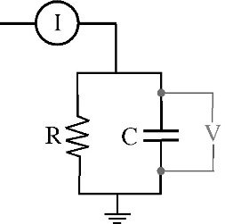
RC circuits
In this circuit, a current step like this:
This means current is going into the circuit
I
This means that voltage is being measured across the capacitor.
(NB: The voltage is the same across every element of a parallel circuit, so the same voltage drops across the resistor.)
produces a voltage response like this:
V
τ = RC

Slide 21
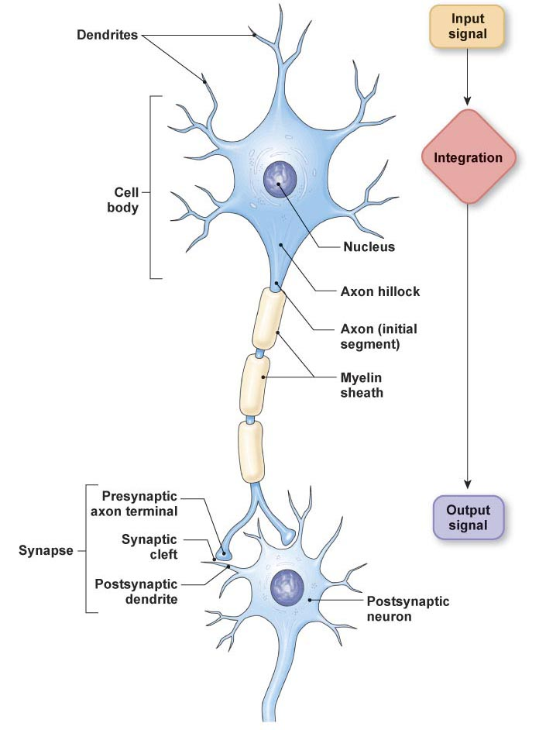
Different types of propagation/transmission
{
3. Graded potentials
{
1. Action potentials
}
2. Synaptic transmission
3. Graded potentials

Slide 22
Different types of propagation/transmission
{
3. Graded potentials
{
1. Action potentials
}
2. Synaptic transmission
3. Graded potentials

Slide 23
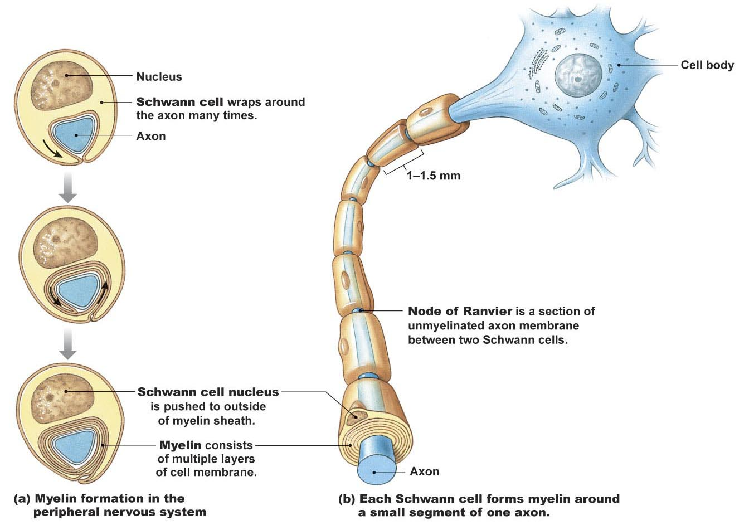
Peripheral neurons are myelinated by Schwann cells Central neurons are myelinated by oligodendrocytes

Slide 24
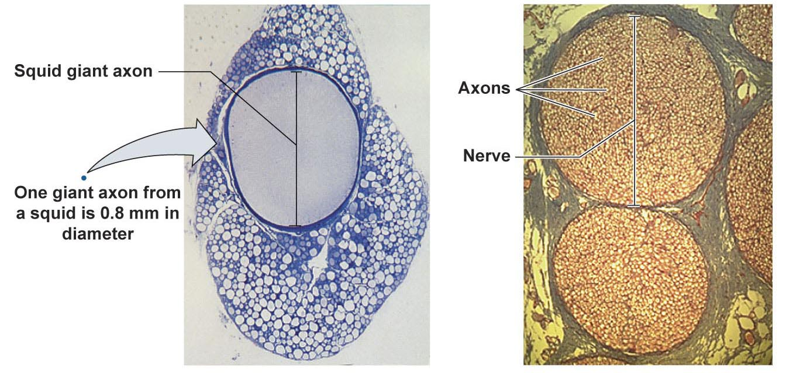
Myelination allows for rapid propagation at a small axon diameter

Slide 25
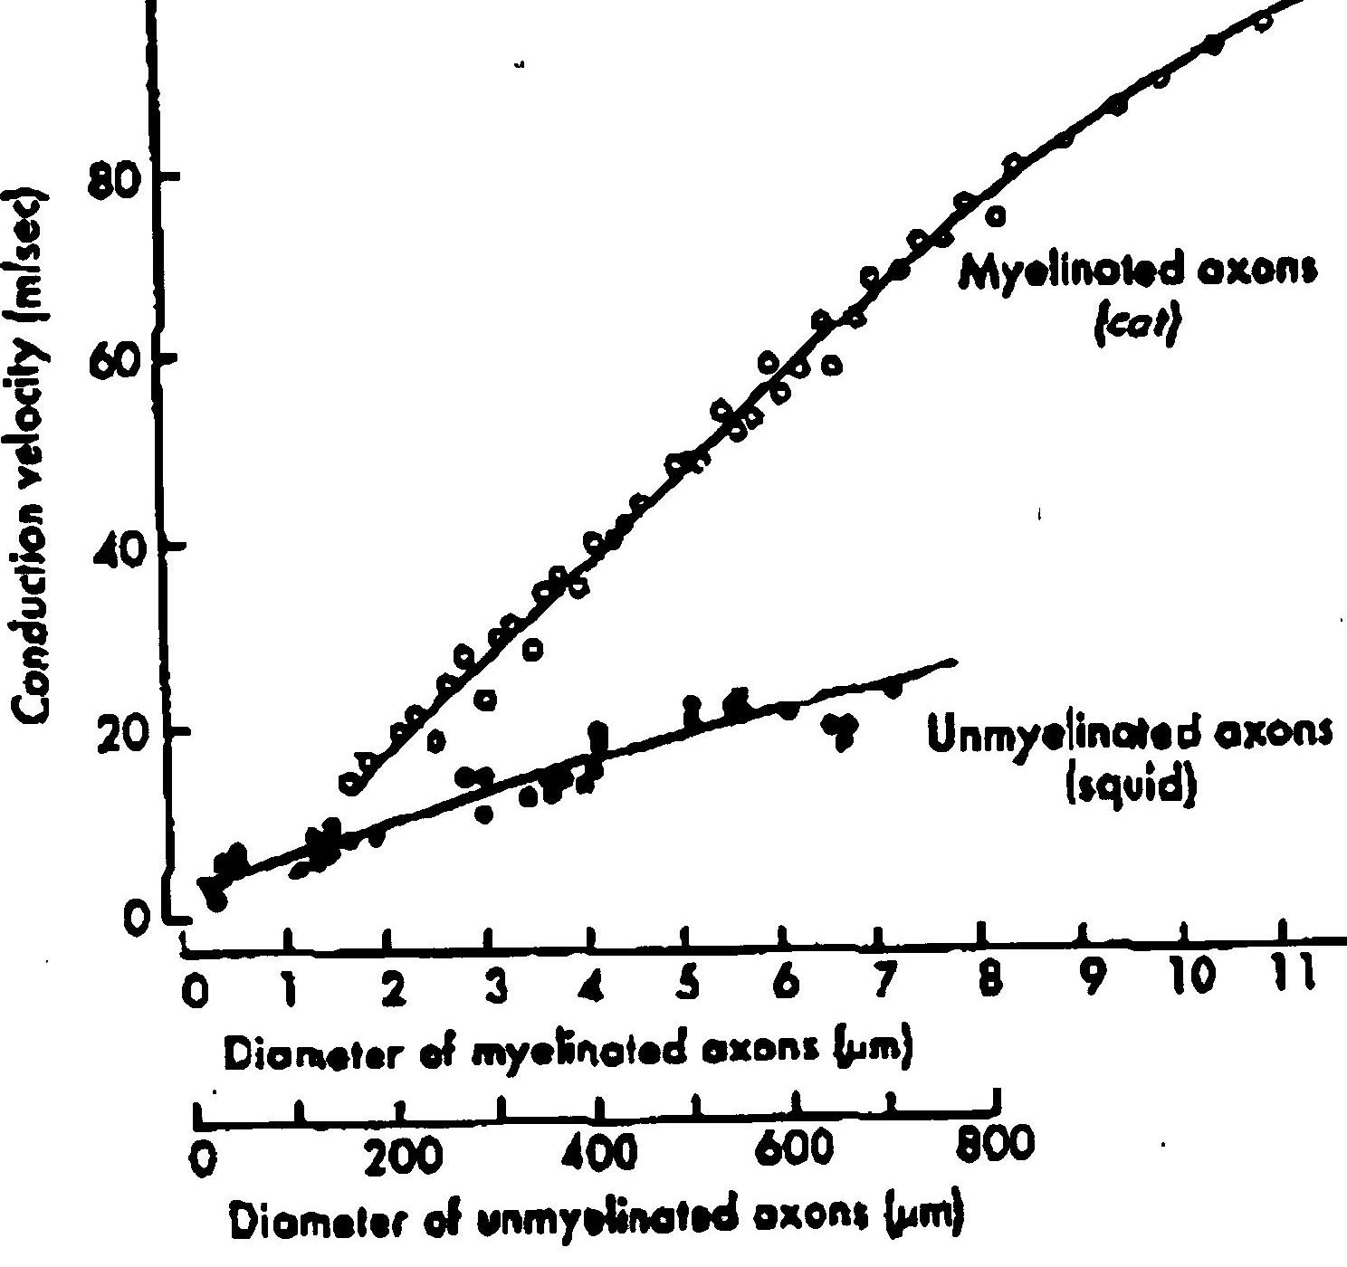
Comparison of conduction velocity between myelinated and unmyelinated axons

Slide 26
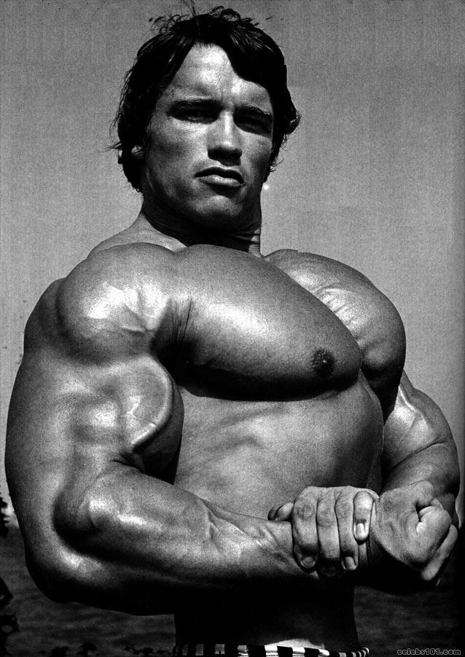
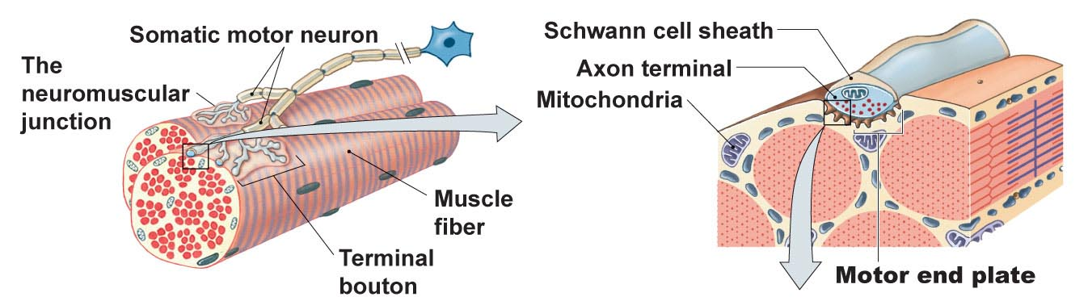
Resting membrane potential and action potentials in muscle cells

Slide 27
Two types of ion channels for action potential propagation
Voltage-gated Na⁺ channels:
+
depolarization
Positive feedback
+
+
• depolarizes cell to its
maximum value
Na⁺ entry
GNa⁺
[ E_{Na} ]
_
Voltage-gated K+ channels:
depolarization
+
Negative feedback
+
• returns to resting potential
K⁺ exit
GK⁺
[ V_{m} ]

Slide 28
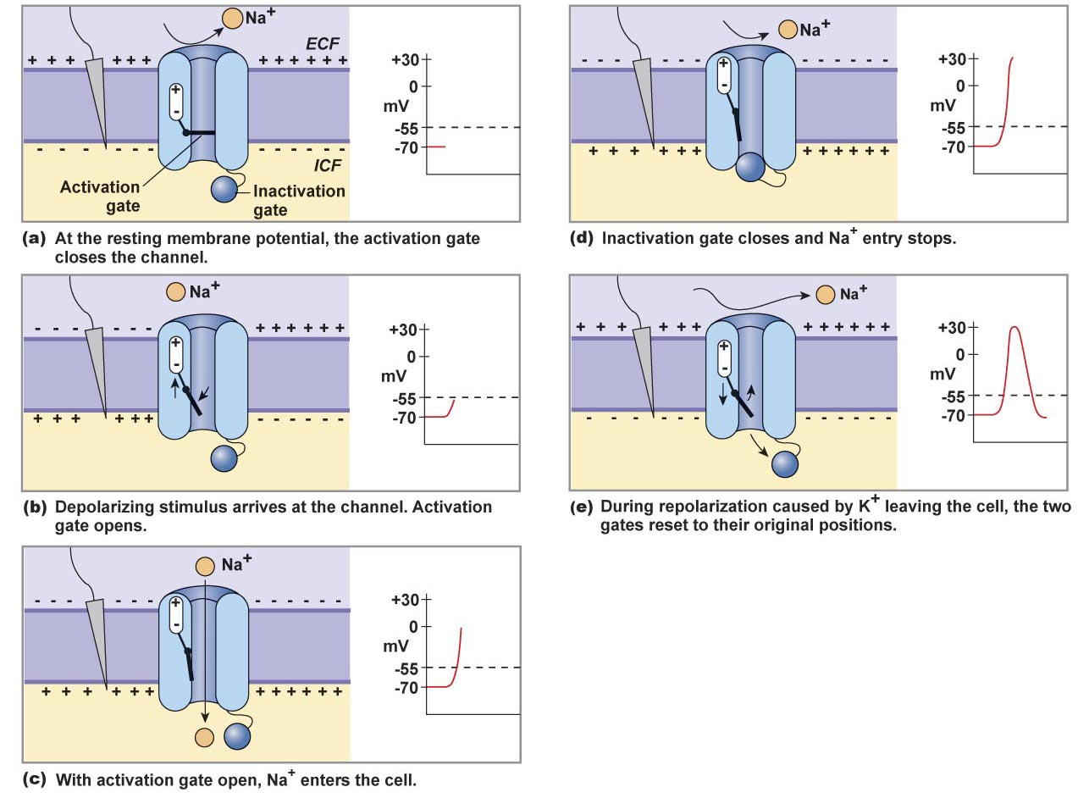
The positive feedback is terminated by the inactivation gate

Slide 29
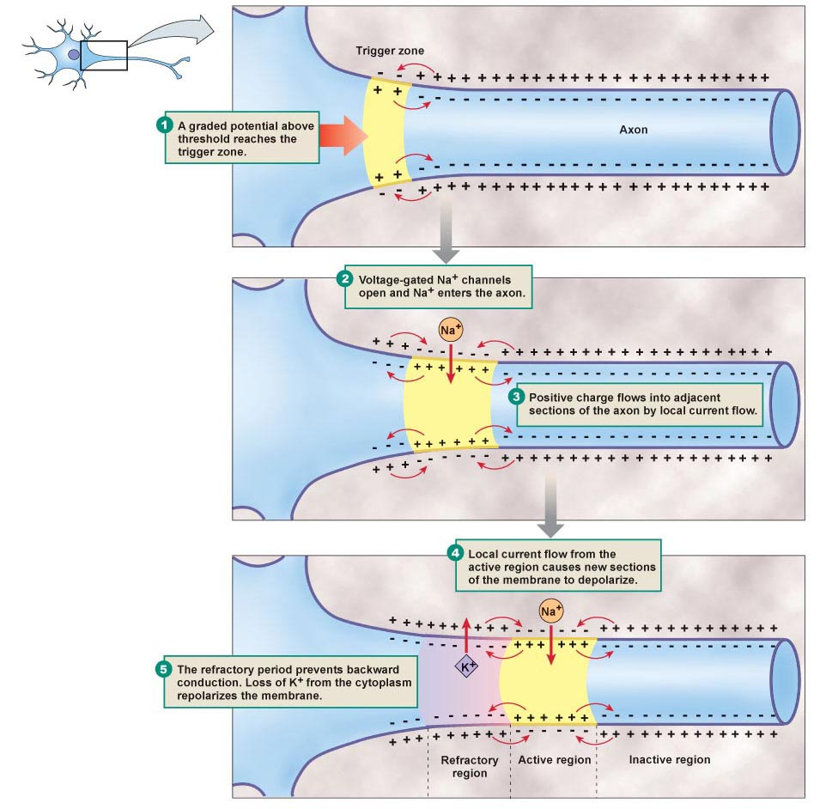
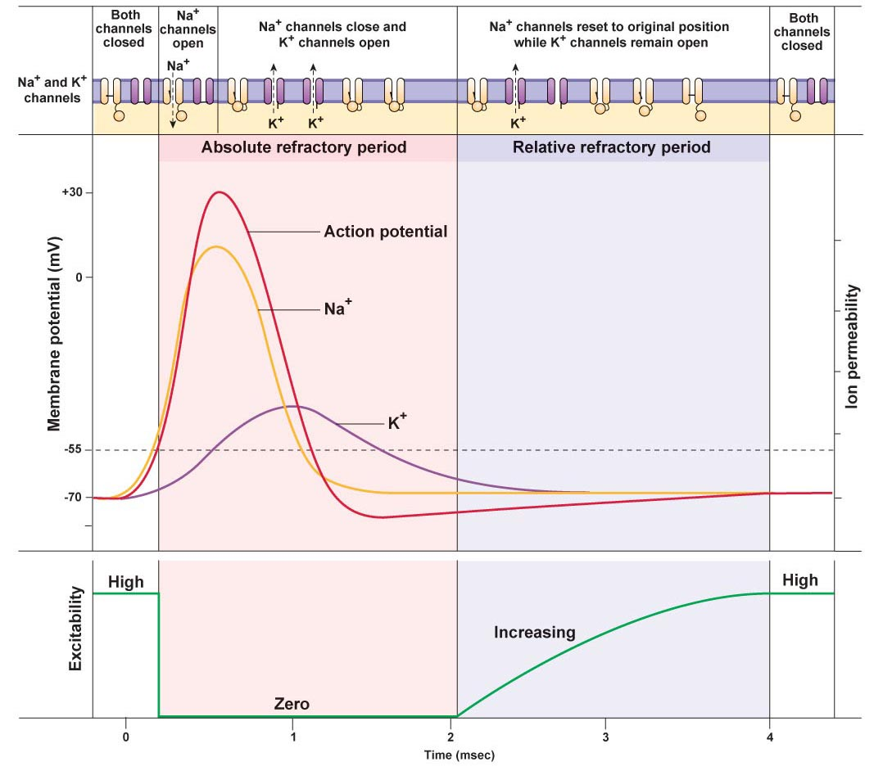
Action potential propagation is a
‘domino effect’.
The stimulus is a graded potential that enters the trigger zone
The depolarization opens Na+ channels, Na+ enters the axon, and the axon initial segment depolarizes
Positive charge from the depolarized trigger zone spreads to adjacent sections of the membrane
In advance of the action potential,
the process continues with (2). In the wake of the action potential, inactivate sodium channels bring the process to an end.

Slide 30
Only a larger than normal stimulus can initiate a new action potential and new action potentials have a smaller peak amplitude

Slide 31
ACTION POTENTIAL INITIATION
If an action potential is initiated half-way between the cell body and the action terminal, it travels
towards the cell body
towards the axon terminal
towards the cell body and the axon terminal
neither towards the cell body and nor towards the axon terminal because it cannot propagate.

Slide 32
Different types of propagation/transmission
{
3. Graded potentials
{
1. Action potentials
}
2. Synaptic transmission
3. Graded potentials

Slide 33
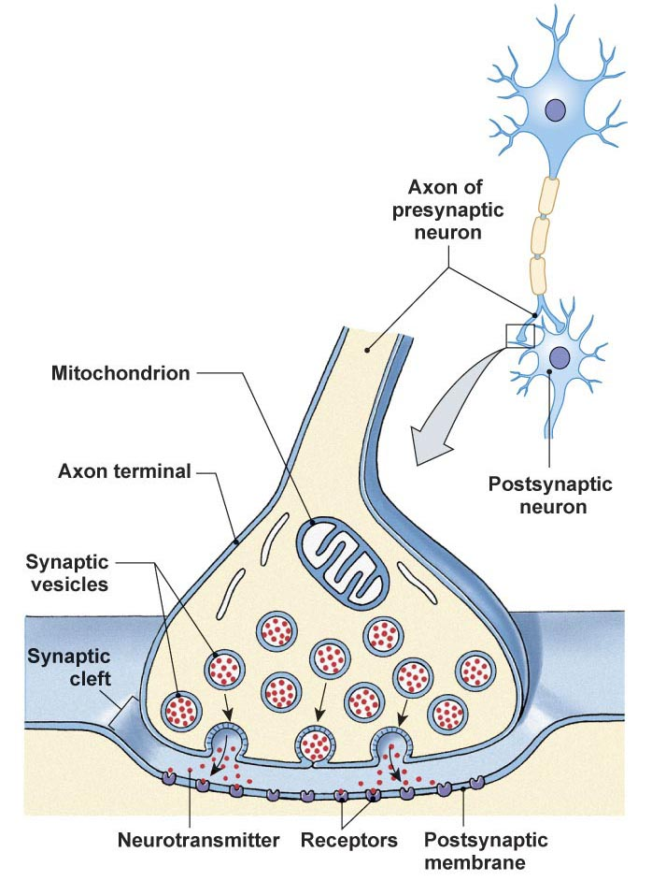
Figure 8-19 see also Fig. 8-20

Slide 34
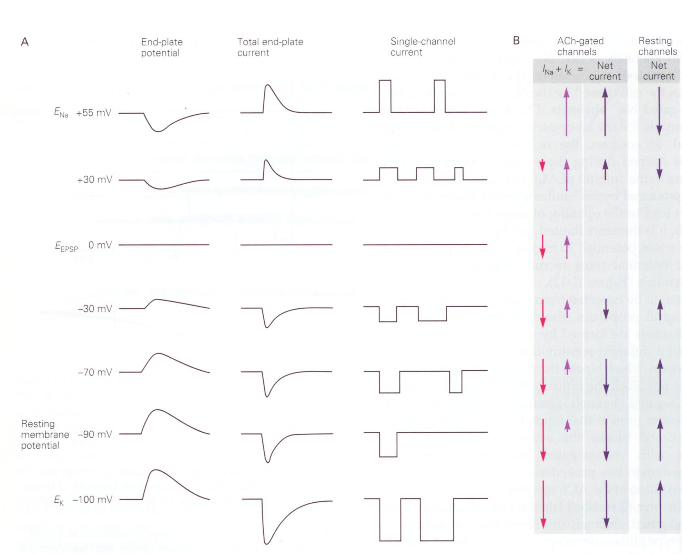
Reversal potential is the potential when the net current flow through a channel reverses.
The net current is zero at the reversal potential.
E_{Na}
+60 mV
+30 mV
E_{rev}
0 mV
Membrane potential
-30 mV
-70 mV
If the channel is only permeable to a single type of ion (e.g., K+) the reversal potential is equal to the equilibrium potential for the ion
-90 mV
E_{K}
-100 mV

Slide 35
Seven classes of neurotransmitters (neurocrines)
Acetylcholine
Amines (made from amino acids, amino acid derivatives)
Dopamine (dopaminergic), Norepinephrine (noradrenergic), Epinephrine (adrenergic); made from tyrosine
Serotonin; made from tryptophan
Histamine; made from histidine
(3) Amino Acids
Glutamate
Aspartate
Gamma-aminobutyric acid (GABA)
Glycine
(4) Purines
Adenosine
(5) Gases
NO (nitric oxide)
(6) Peptides
(7) Lipids
Eicosanoids; ligands for the cannabinoid receptor

Slide 36
Examples of receptor types
Acetylcholine
Nicotinic (ionotropic; monovalent cation channels)
Muscarinic (metabotropic; coupled to G-proteins and linked to second messenger systems), e.g., opens K+ channel AND/OR opens Cl- channel
Norepinephrine (noradrenergic)
Alpha-receptors (metabotropic; coupled to G-proteins and linked to second messenger systems)
alpha 1 – activate phospholipase C, increase in inositol triphosphate (IP3) and diacylglycerol (DAG)
alpha 2 – inhibit adenylyl cyclase, decrease in cAMP
Beta-receptors (metabotropic; coupled to G-proteins and linked to second messenger systems) – increase in cAMP
Glutamate
Metabotropic glutamate receptors (G-protein coupled receptors)
Ionotropic glutamate receptors
AMPA-receptors (ligand gated monovalent cation channels)
NMDA-receptors (cation channels; require both glutamate binding and a change in membrane potential; blocked by Mg++ at resting membrane potentials)

Slide 37
Different types of propagation/transmission
{
3. Graded potentials
{
1. Action potentials
}
2. Synaptic transmission
3. Graded potentials

Slide 38
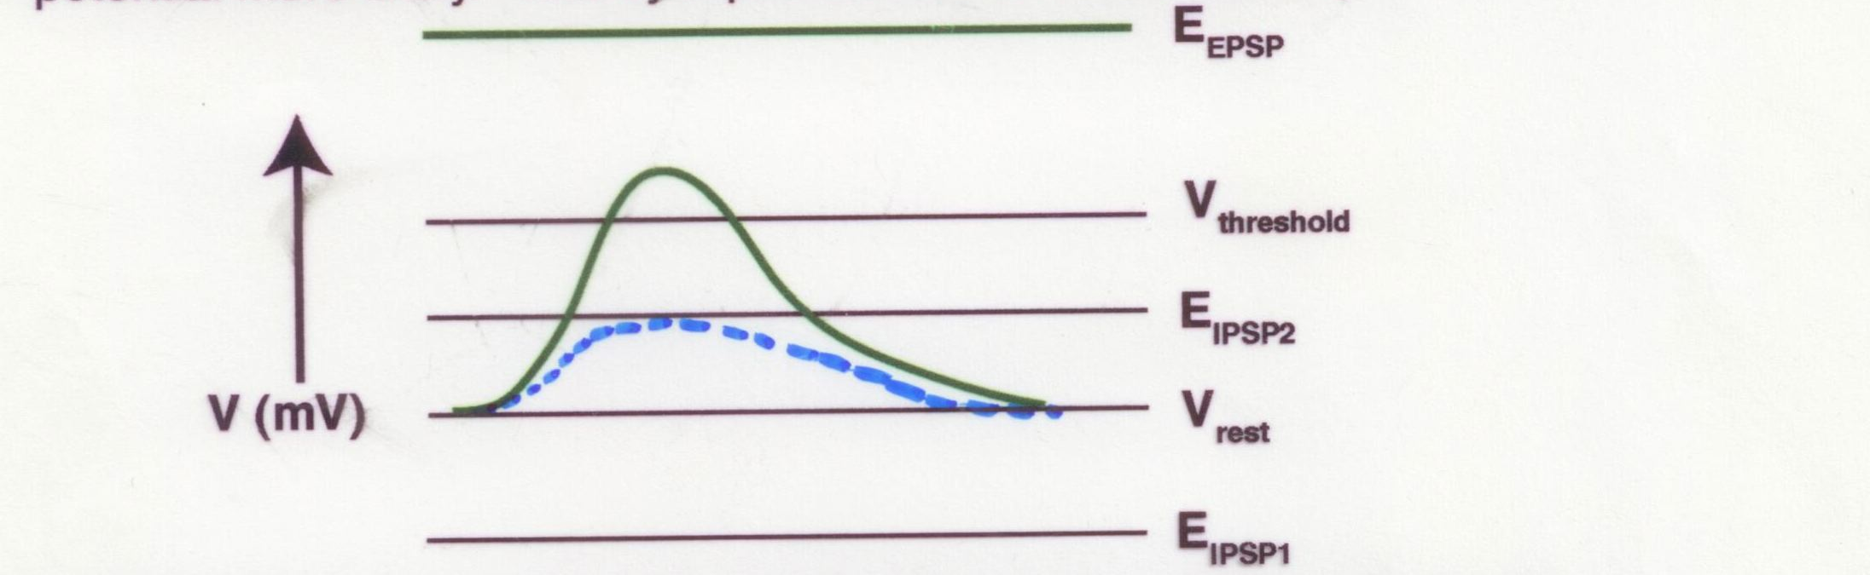
Postsynaptic potentials depend on the channels that are opened
Monovalent cation channel, Excitatory:
Reversal potential (E_{EPSP}) is more positive than
the threshold potential (V_{threshold})
Green line: excitatory PSP (EPSP), depolarizing

Slide 39
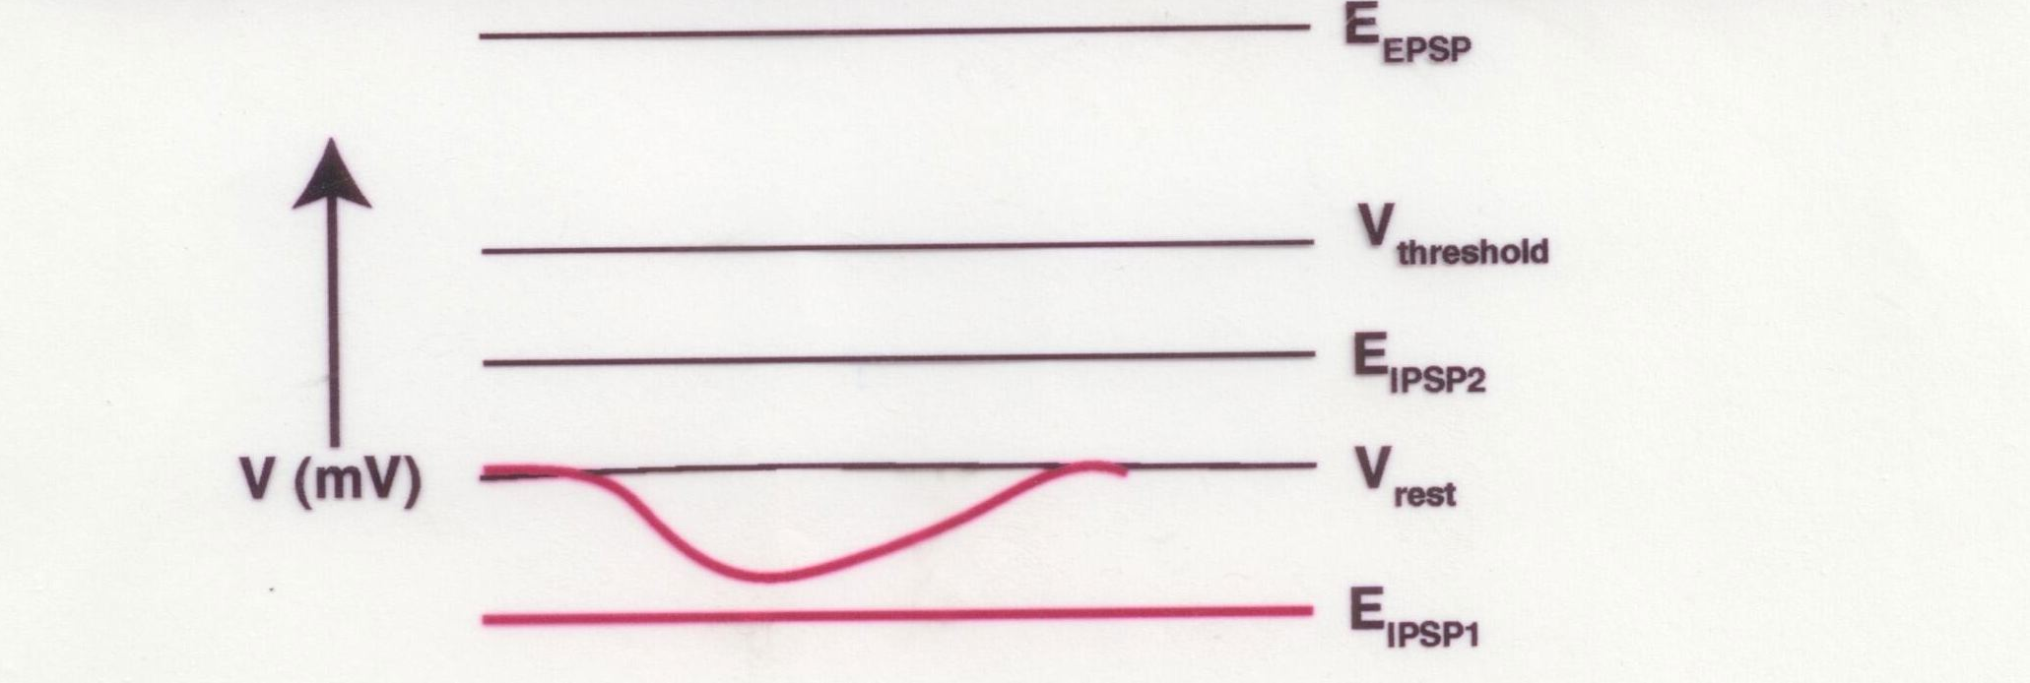
Postsynaptic potentials depend on the channels that are opened
K+ channel, inhibitory:
Reversal potential (E_{IPSP}) is more negative than
the threshold potential (V_{threshold})
Red line: inhibitory PSP (IPSP), hyperpolarizing

Slide 40
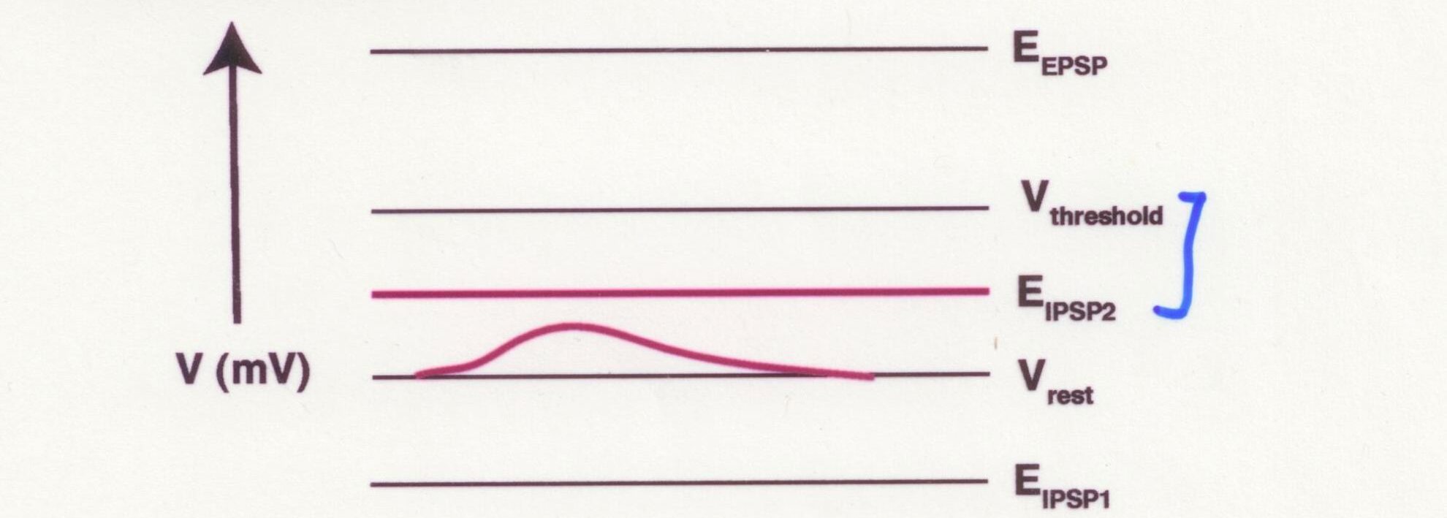
Postsynaptic potentials depend on the channels that are opened
Cl- channel, inhibitory:
Reversal potential (E_{IPSP}) is more negative than
the threshold potential (V_{threshold})
Red line: inhibitory PSP (IPSP), ?polarizing

Slide 41
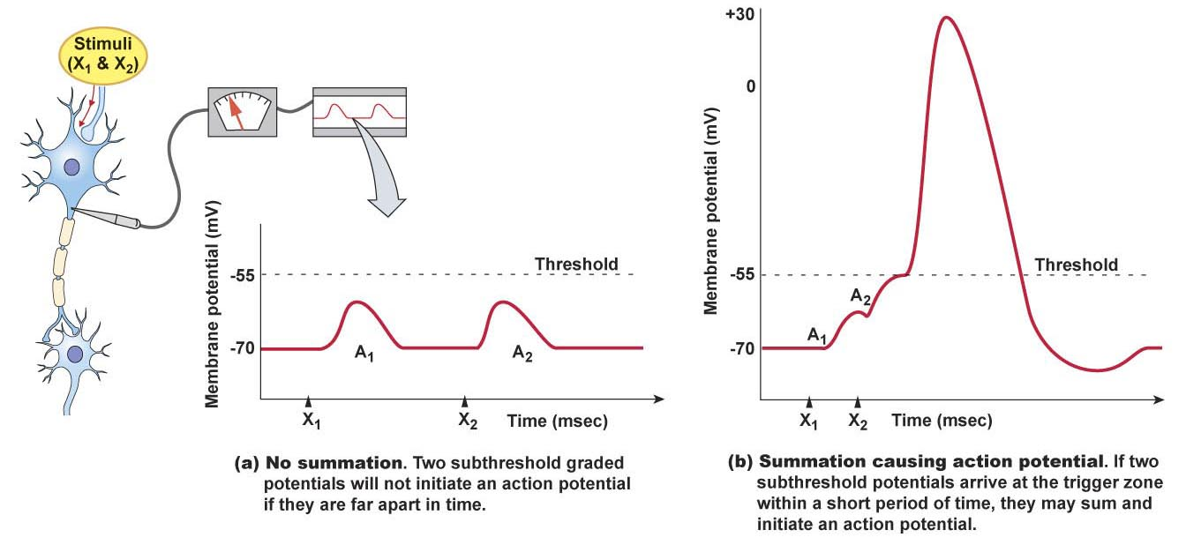
Successive PSPs at the same synapse can combine to result in a summed PSP
Figure 8-24

Slide 42
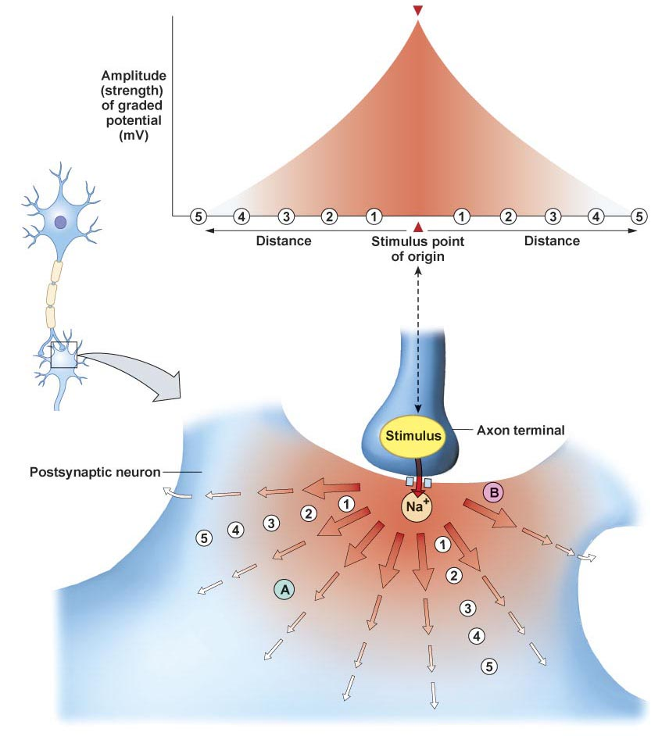
Postsynaptic potentials are graded

Slide 43
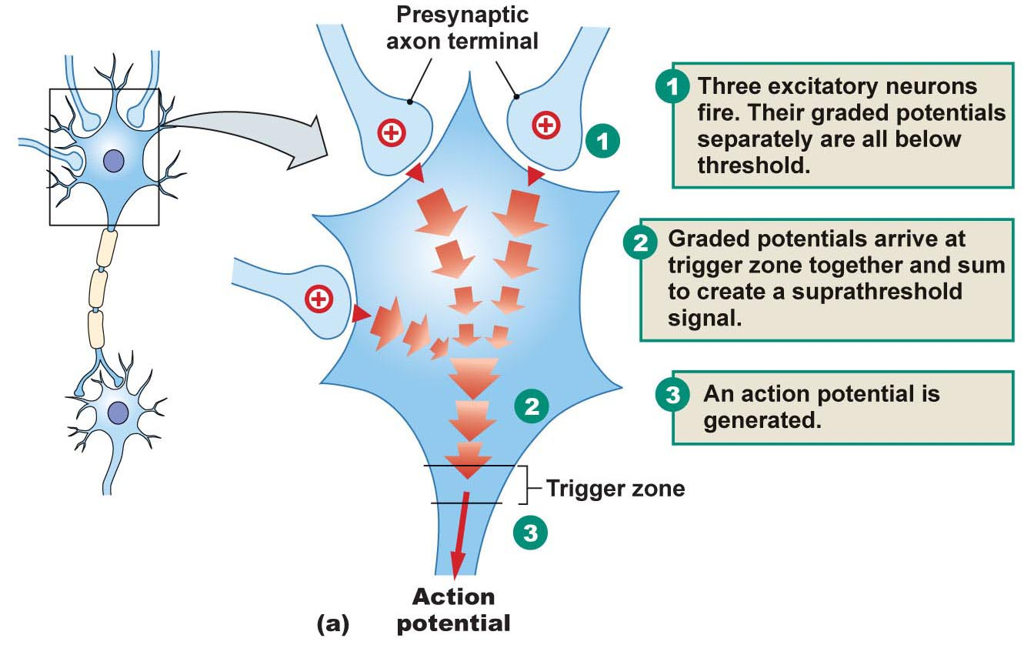
Simultaneous PSP at different synapses combine to result in a summed PSP
Figure 8-24

Slide 44
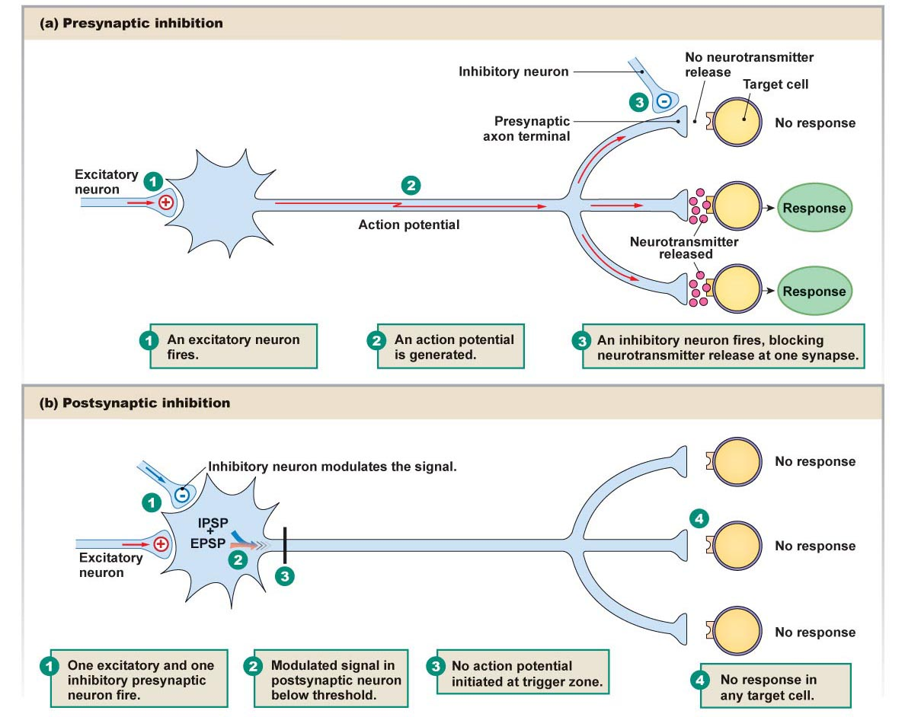
Inhibitory PSPs subtract from the excitatory PSPs
Figure 8-26

